Slide 1

How (not) to use arguments

Slide 2
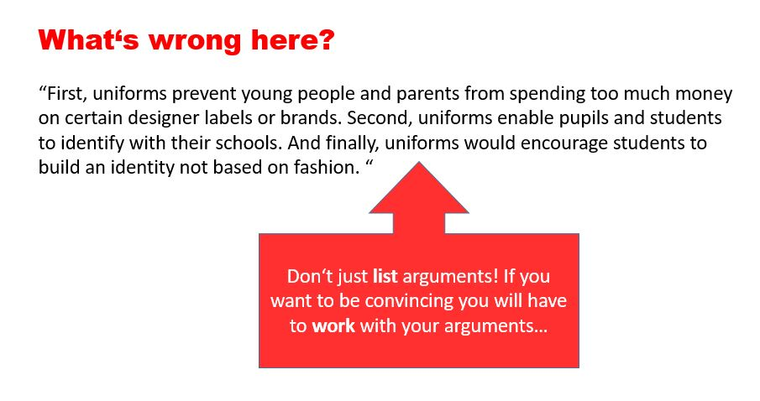

Slide 3
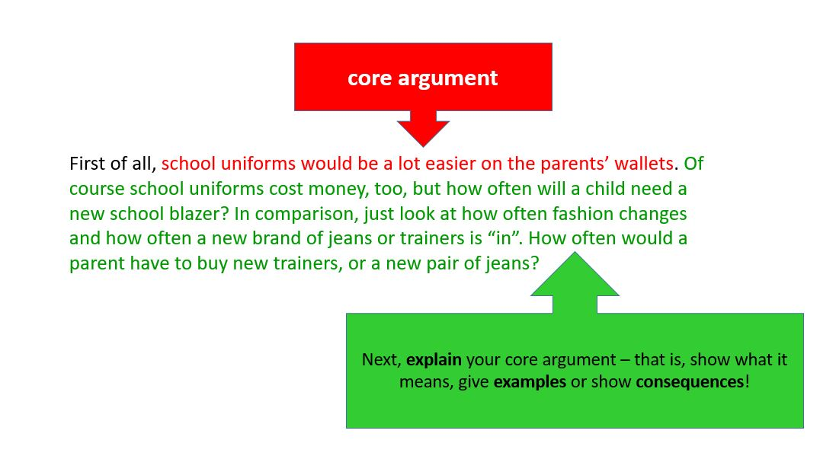

Slide 4
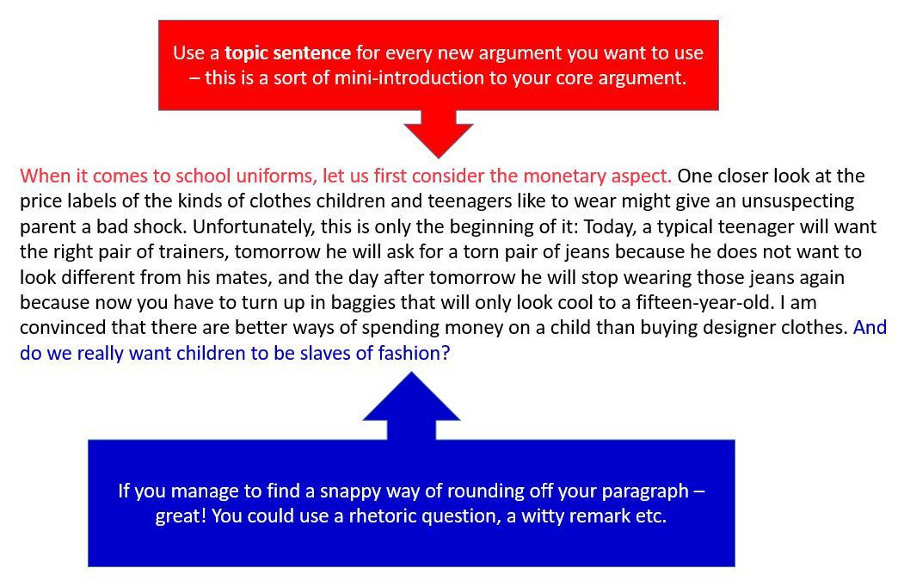

Slide 5
CC-BY 4.0

